Slide 1
Expert System &Artificial Intelligence BM-766
Modified slides of Prof. M. Batouche, KSU, and AI course on Udacity.

Slide 2
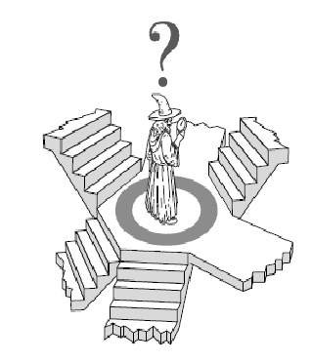
Local Search
Local Search for optimization :
hill climbing, simulated annealing

Slide 3
Local Search Methods
Applicable when seeking Goal State & don't care how to get there. E.g.,
N-queens,
finding shortest/cheapest round trips
(Travel Salesman Problem, Vehicle Routing Problem)
finding models of propositional formulae (SAT solvers)
VLSI layout, planning, scheduling, time-tabling, . . .
map coloring,
resource allocation
protein structure prediction
genome sequence assembly

Slide 4
Local Search Algorithms
In many optimization problems, the path to the goal is irrelevant; the goal state itself is the solution
State space = set of configurations
Find a configuration satisfying your constraints, e.g., n-queens
Find the best possible state according to a given objective function
In such cases, we can use local search algorithms
Keeps a single "current" state, and then shift states, but don’t keep track of paths.
Use very limited memory
Find reasonable solutions in large state spaces.

Slide 5
Local search
Key idea (surprisingly simple):
Select (random) initial state (generate an initial guess)
Make local modification to improve current state (evaluate current state and move to other states)
Repeat Step 2 until goal state found (or out of time)

Slide 6
Local Search Algorithms
Hill Climbing,
Simulated Annealing,
Tabu Search
These are called “anytime algorithms”.
They can return a valid solution even if they are interrupted at any time before they properly terminate

Slide 7

Hill Climbing
"Like climbing Everest in thick fog with amnesia"
Hill climbing search algorithm (a.k.a greedy local search) uses a loop that continually moves in the direction of increasing values (that is uphill).
It teminates when it reaches a peak where no neighbor has a higher value.

Slide 8
Hill-Climbing Algorithm
It is an iterative algorithm that starts with an arbitrary solution to a problem and attempts to find a better solution by changing a single element of the solution incrementally. If the change produces a better solution, an incremental change is taken as a new solution. This process is repeated until there are no further improvements.

Slide 9
Hill-Climbing Algorithm
Pick a random point in the search space
Consider all the neighbors of the current state
Choose the neighbor with the best quality and move to that state
Repeat 2 to 4 until all the neighboring states are of lower quality
Return the current state as the solution state.

Slide 10
Hill-Climbing
function Hill-Climbing (problem), returns a state that is a local maximum.
Function hill ()
{ queue = []; // initialize an empty queue
state = root_node; // initialize the start state
while (true)
{
if is_goal (state) then return SUCCESS
else
{
sort (successors (state));
add_to_front_of_queue (successors (state));
}
if queue == [] then report FAILURE;
state = queue [0]; // state = first item in queue
remove_first_item_from (queue);
}

Slide 11
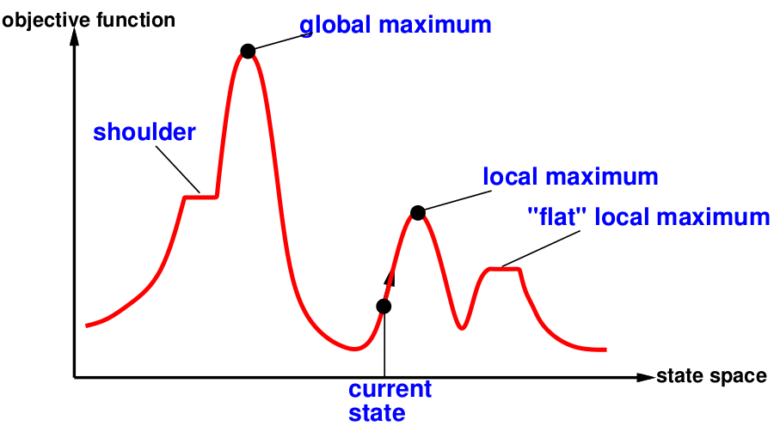
State Space Landscape
A state space landscape is a graph of states associated with their costs

Slide 12
Hill Climbing
evaluation
states

Slide 13
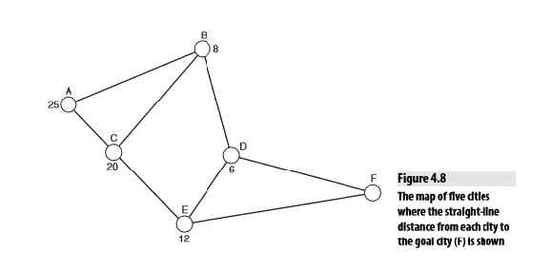
Steepest Ascent Hill Climbing
This algorithm thus searches the tree in a depth-first manner, at each step choosing paths that appear to be most likely to lead to the goal.

Slide 14
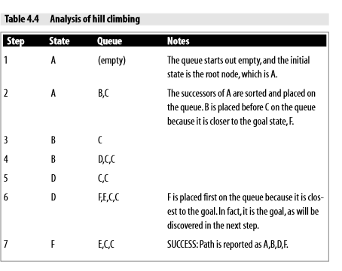

Slide 15
Hill-Climbing Problems
Greedy Local Search: grabs a good neighbor state without thinking about where to go next
However, greedy algos do make good progress generally towards the solution
Unfortunately, hill-climbing
Can get stuck in local maxima
Can be stuck by ridges (a series of local maxima that occur close together)
Can be stuck by plateau (a flat area in the state space landscape)
Shoulder: if the flat area rises uphill later on
Flat local maximum: no uphill rise exists.

Slide 16
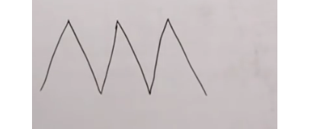

Slide 17
Improvements
Stochastic Hill Climbing: Chooses at random from amongst the uphill moves, based on a probability distribution
First-choice Hill Climbing: Implements stochastic HC by generating successors randomly until one is generated that is better than the current state
Random-restart Hill Climbing: Selects a series of initial nodes randomly until the solution is found.

Slide 18
Local Search Algorithms
Simulated Annealing
(Stochastic hill climbing …)

Slide 19
Simulated Annealing
Basic inspiration: What is annealing?
In mettallurgy, annealing is the physical process used to temper or harden metals or glass by heating them to a high temperature and then gradually cooling them, thus allowing the material to coalesce into a low energy cristalline state.
Heating then slowly cooling a substance to obtain a strong cristalline structure.
Key idea: Simulated Annealing combines Hill Climbing with a random walk in some way that yields both efficiency and completeness.

Slide 20
Simulated Annealing
Take some uphill steps to escape the local minimum
Instead of picking the best move, it picks a random move
If the move improves the situation, it is executed. Otherwise, move with some probability less than 1.
Physical analogy with the annealing process:
Allowing liquid to gradually cool until it freezes
The heuristic value is the energy, E
Temperature parameter, T, controls speed of convergence.

Slide 21
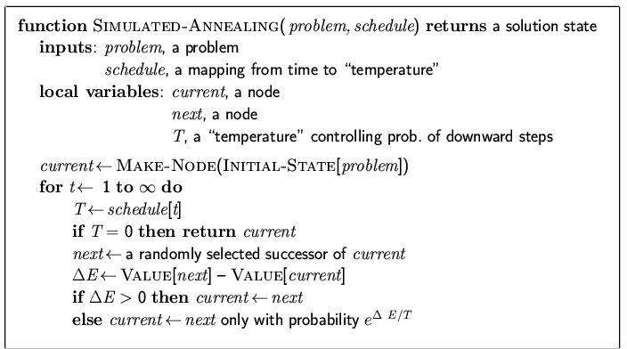
Simulated annealing search
Idea: escape local maxima by allowing some "bad" moves but gradually decrease their frequency

Slide 22
Properties of simulated annealing search
One can prove: If T decreases slowly enough, then simulated annealing search will find a global optimum with probability approaching 1
Widely used in VLSI layout, airline scheduling, etc.

Slide 23
Simulated Annealing

Slide 24
Simulated Annealing
Temperature T
Used to determine the probability
High T : large changes
Low T : small changes
Cooling Schedule
Determines rate at which the temperature T is lowered
Lowers T slowly enough, the algorithm will find a global optimum
In the beginning, aggressive for searching alternatives, become conservative when time goes by

Slide 25

Questions

